Slide 1
MUTHAYAMMAL ENGINEERING COLLEGE (AUTONOMOUS),
RASIPURAM – 637 408
DEPARTMENT OF INFORMATION TECHNOLOGY
Artificial Intelligence
14.07.2016
Prepared by,
M.Dhamodaran
Assistant Professor / IT
Muthayammal Engineering College

Slide 2
AI Definitions
The study of how to make programs/computers do things that people do better
The study of how to make computers solve problems which require knowledge and intelligence
The exciting new effort to make computers think … machines with minds
The automation of activities that we associate with human thinking (e.g., decision-making, learning…)
The art of creating machines that perform functions that require intelligence when performed by people
The study of mental faculties through the use of computational models
A field of study that seeks to explain and emulate intelligent behavior in terms of computational processes
The branch of computer science that is concerned with the automation of intelligent behavior
Thinking machines or machine intelligence
Studying cognitive faculties
Problem Solving and CS

Slide 3
So What Is AI?
AI as a field of study
Computer Science
Cognitive Science
Psychology
Philosophy
Linguistics
Neuroscience
AI is part science, part engineering
AI often must study other domains in order to implement systems
e.g., medicine and medical practices for a medical diagnostic system, engineering and chemistry to monitor a chemical processing plant
AI is a belief that the brain is a form of biological computer and that the mind is computational
AI has had a concrete impact on society but unlike other areas of CS, the impact is often
felt only tangentially (that is, people are not aware that system X has AI)
felt years after the initial investment in the technology

Slide 4
What is Intelligence?
Is there a “holistic” definition for intelligence?
Here are some definitions:
the ability to comprehend; to understand and profit from experience
a general mental capability that involves the ability to reason, plan, solve problems, think abstractly, comprehend ideas and language, and learn
is effectively perceiving, interpreting and responding to the environment
None of these tells us what intelligence is, so instead, maybe we can enumerate a list of elements that an intelligence must be able to perform:
perceive, reason and infer, solve problems, learn and adapt, apply common sense, apply analogy, recall, apply intuition, reach emotional states, achieve self-awareness
Which of these are necessary for intelligence? Which are sufficient?
Artificial Intelligence – should we define this in terms of human intelligence?
does AI have to really be intelligent?
what is the difference between being intelligent and demonstrating intelligent behavior?

Slide 5
Physical Symbol System Hypothesis
A physical symbol system (PSS)
consists of symbols (patterns) which are combinable into expressions
there are processes which operate on these symbols to create new symbols and expressions
consider for instance English as a physical symbol system
symbols are the alphabet
expressions are words and sentences
the processes are the English grammar and parsers and dictionaries
The PSS Hypothesis states that a PSS has the necessary and sufficient means for intelligent action
a computer is a PSS
if the PSS Hypothesis is true, then it should be possible to program a computer to produce intelligent actions
this is the (or a) goal of AI
if the PSS Hypothesis is not true, what are the consequences for AI?

Slide 6
The Turing Test
1950 – Alan Turing devised a test for intelligence called the Imitation Game
Ask questions of two entities, receive answers from both
If you can’t tell which of the entities is human and which is a computer program, then you are fooled and we should therefore consider the computer to be intelligent
Questions
Answers
Answers
Which is the person?
Which is the computer?

Slide 7
Solving the Turing Test: Eliza
Created by Joseph Weizenbaum
This system would act like a Rogerian psychoanalyst by holding a dialog with a person
the dialog would be consist of the doctor (Eliza) asking questions, the human responding, and the doctor using the response to ask another question
Weizenbaum wrote the program so that it would generate an English response/question based on a group of patterns
If the user sentence matched a pattern, this pattern would be used to generate the next sentence/question
A more recent, and much superior version is called A.L.I.C.E, see http://alicebot.blogspot.com/
click on “chat with A.L.I.C.E.”

Slide 8
Example Eliza Dialog
H: Men are all alike
E: In what way?
H: They’re always bugging us about something or another.
E: Can you be more specific?
H: Well, my boyfriend made me come here.
E: Your boyfriend made you come here?
H: He says I’m depressed much of the time.
E: I am sorry to hear you are depressed.
H: It’s true. I am unhappy.
E: Do you think coming here will help you not to be unhappy?
H: I need some help, that much seems certain.
E: What would it mean to you if you got some help?
H: Perhaps I could learn to get along with my mother.
E: Tell me more about your family

Slide 9
Eliza Rules
(?* ?x) hello (?* ?y) →
(How do you do. Please state your problem.)
(?* ?x) I want (?* ?y) →
(What would it mean if you got ?y)
(Why do you want ?y)
(Suppose you got ?y soon)
(?* ?x) if (?* ?y) →
(Do you really think its likely that ?y)
(Do you wish that ?y)
(What do you think about ?y) (Really-- if ?y)
(?* ?x) no (?* ?y) → (Why not?)
(You are being a bit negative)
(Are you saying "NO" just to be negative?)
(?* ?x) I was (?* ?y) → (Were you really?)
(Perhaps I already knew you were ?y)
(Why do you tell me you were ?y now?)
(?* ?x) I feel (?* ?y) → (Do you often feel ?y ?)
(?* ?x) I felt (?* ?y) →
(What other feelings do you have?)
Eliza also has a
rule to swap
‘I’ and ‘my’
to ‘you’ and ‘your’

Slide 10
Eliza Pattern Syntax
pat ➔ var match any one expression to a variable
constant or to a constant (see below)
segment-pat match against a sequence
single-pat match against one expression
(pat . pat) match the first and the rest of a list
single-pat ➔
(?is var predicate) test predicate on one expression
(?or pat1 pat2 …) match on any of the patterns
(?and pat1 pat2 …) match on every of the expressions
(?not pat) match if expression does not match
segment-pat ➔
((?* var) …) match on zero or more expressions
((?+ var) …) match on one or more expressions
((?? var) …) match zero or one expression
((?if expr) …) test if expression is true
var ➔ ?chars variables of the form ?name
constant ➔ atom symbols, numbers, chars

Slide 11
ALICE Demo
Jerry: my name is jerry.
ALICE: Hey jerry.
Jerry: do you know Turing?
ALICE: A brilliant and tragic figure in the history of computer science.
Jerry: who else do you know?
ALICE: Hugh Loebner, Robby Garner, and Steven Spielberg
Jerry: which film do you like?
ALICE: My favorite movie is Teknolust. Have you seen it?
Jerry: no.
ALICE: I would recommend you check it out.
Jerry: what is it about?
ALICE: Science fiction.
Jerry: do you remember my name?
ALICE: Your name is jerry, seeker.
Notice unlike Eliza, ALICE has a memory, can handle references
(have you seen it? no. I would recommend it.)

Slide 12
ALICE vs. Eliza
ALICE talking to ELIZA
ELIZA: I am ELIZA.
ALICE: I am very pleased to meet you ELIZA.
ELIZA: How can I help you?
ALICE: Just keep talking to me as long as you can.
ELIZA: Do you wish to as long as me?
ALICE: OK, I will as long as you.
ELIZA: Do you wish to will as long as me?
ALICE: OK, I will will as long as you.
ELIZA: Do you wish to will will as long as me?
ALICE: OK, I will will will as long as you.
ELIZA: Do you wish to will will will as long as me?
ALICE: OK, I will will will will as long as you.
ELIZA: Do you wish to will will will will as long as me?
ALICE: OK, I will will will will will as long as you.
ELIZA: Do you wish to will will will will will as long as me?
…
Eliza gets stuck on the phrase “I will” and then ALICE gets stuck
on the same phrase

Slide 13
How Useful is the Turing Test?
With Eliza or Alice like rules, we can eventually solve the Turing Test – it just takes writing enough rules
Does the system understand what it is responding to?
No, neither Eliza nor Alice understand the text, its just that Alice has better, more in depth and wider ranging rules
However, we could build a representation that models some real-world domain and knowledge base
The system can fill in information from the conversation
this is sort of like a database, or an object with data attributes to be filled in
we can use a variety of AI representations like scripts, frames, semantic networks
Questions can be responded to by looking up the stored data
In this way, the system is responding, not based merely on “canned” knowledge, but on knowledge that it has “learned”
Does this imply that the system knows what it is discussing?
What does it mean to know something?

Slide 14
Table-Lookup vs. Reasoning
Consider two approaches to programming a Tic-Tac-Toe player
Solution 1: a pre-enumerated list of best moves given the board configuration
Solution 2: rules (or a heuristic function) that evaluate a board configuration, and using these to select the next best move
Solution 1 is similar to how Eliza works
This is not practical for most types of problems
Consider solving the game of chess in this way, or trying to come up with all of the responses that a Turing Test program might face
Solution 2 will reason out the best move
Given the board configuration, it will analyze each available move and determine which is the best
Such a player might even be able to “explain” why it chose the move it did
We can (potentially) build a program that can pass the Turing Test using table-lookup even though it would be a large undertaking
Could we build a program that can pass the Turing Test using reasoning?
Even if we can, does this necessarily mean that the system is intelligent?

Slide 15
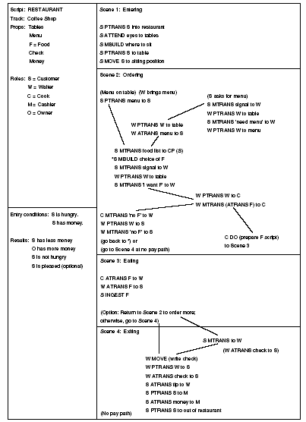
Slot Filling
Roger Schank created the Script representation
the script describes typical sequences of actions and actors for some real-world situation
a story (newspaper article) is parsed and slots are filled in
SAM (Script Applier Mechanism) uses the filled in script to answer questions
The Script provides the knowledge needed to respond like a human and thus solve the Turing Test
Schank’s Restaurant script

Slide 16
The Chinese Room Problem
From John Searle, Philosopher, in an attempt to demonstrate that computers cannot be intelligent
The room consists of you, a book, a storage area (optional), and a mechanism for moving information to and from the room to the outside
a Chinese speaking individual provides a question for you in writing
you are able to find a matching set of symbols in the book (and storage) and write a response, also in Chinese
Question (Chinese)
Answer
(Chinese)
Storage
You
Book of Chinese Symbols

Slide 17
Chinese Room: An Analogy for a Computer
Note: Searle’s original Chinese Room actually was based on a
Script that was implemented in Chinese, our version is just a
variation on the same theme
User
Input I/O pathway (bus) Output
Memory Program/Data
(Script) CPU (SAM)

Slide 18
Searle’s Question
You were able to solve the problem of communicating with the person/user and thus you/the room passes the Turing Test
But did you understand the Chinese messages being communicated?
since you do not speak Chinese, you did not understand the symbols in the question, the answer, or the storage
can we say that you actually used any intelligence?
By analogy, since you did not understand the symbols that you interacted with, neither does the computer understand the symbols that it interacts with (input, output, program code, data)
Searle concludes that the computer is not intelligent, it has no “semantics,” but instead is merely a symbol manipulating device
the computer operates solely on syntax, not semantics
He defines to categories of AI:
strong AI – the pursuit of machine intelligence
weak AI – the pursuit of machines solving problems in an intelligent way

Slide 19
But Computers Solve Problems
We can clearly see that computers solve problems in a seemingly intelligent way
Where is the intelligence coming from?
There are numerous responses to Searle’s argument
The System’s Response:
the hardware by itself is not intelligent, but a combination of the hardware, software and storage is intelligent
in a similar vein, we might say that a human brain that has had no opportunity to learn anything cannot be intelligent, it is just the hardware
The Robot Response:
a computer is void of senses and therefore symbols are meaningless to it, but a robot with sensors can tie its symbols to its senses and thus understand symbols
The Brain Simulator Response:
if we program a computer to mimic the brain (e.g., with a neural network) then the computer will have the same ability to understand as a human brain

Slide 20
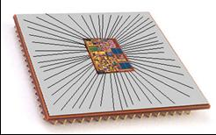
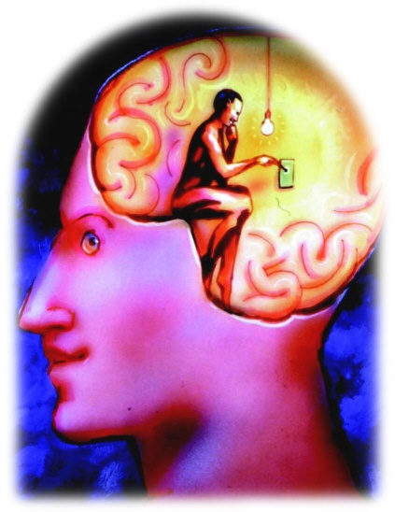
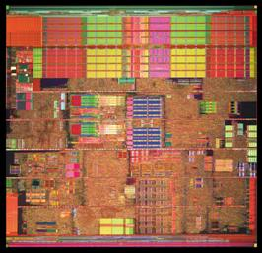
Brain vs. Computer
In AI, we compare the brain (or the mind) and the computer
Our hope: the brain is a form of computer
Our goal: we can create computer intelligence through programming just as people become intelligent by learning
But we see that the computer is not like the brain
The computer performs tasks without understanding what its doing
Does the brain understand what its doing when it solves problems?

Slide 21
Symbol Grounding
One problem with the computer is that it works strictly syntactically
Op code: 10011101 → translates into a set of microcode instructions such as: move IR_{16..31} to MAR, signal memory read, move MBR to AC
There is no understanding
x = y + z; is meaningless to the computer
the computer doesn’t understand addition, it just knows that a certain op code means to move values to the adder and move the result elsewhere
do you know what addition means?
if so, how do you proscribe meaning to +
how is this symbol grounded in your brain?
can computers similarly achieve this?
Recall Schank’s Restaurant script
does the computer know what the symbols “waiter” or “PTRANS” represent? or does it merely have code that tells the computer what to do when it comes across certain words in the story, or how to respond to a given question?

Slide 22
Two AI Assumptions
We can understand and model cognition without understanding the underlying mechanism
That is, it is the model of cognition that is important not the physical mechanism that implements it
If this is true, then we should be able to create cognition (mind) out of a computer or a brain or even other entities that can compute such as a mechanical device
This is the assumption made by symbolic AI researchers
Cognition will emerge from the proper mechanism
That is, the right device, fed with the right inputs, can learn and perform the problem solving that we, as observers, call intelligence
Cognition will arise as the result (or side effect) of the hardware
This is the assumption made by connectionist AI researchers
Notice that while the two assumptions differ, neither is necessarily mutually exclusive and both support the idea that cognition is computational

Slide 23
Problems with Symbolic AI Approaches
Scalability
It can take dozens or more man-years to create a useful systems
It is often the case that systems perform well up to a certain threshold of knowledge (approx. 10,000 rules), after which performance (accuracy and efficiency) degrade
Brittleness
Most symbolic AI systems are programmed to solve a specific problem, move away from that domain area and the system’s accuracy drops rapidly rather than achieving a graceful degradation
this is often attributed to lack of common sense, but in truth, it is a lack of any knowledge outside of the domain area
No or little capacity to learn, so performance (accuracy) is static
Lack of real-time performance

Slide 24
Problems with Connectionist AI Approaches
No “memory” or sense of temporality
The first problem can be solved to some extent
The second problem arises because of a fixed sized input but leads to poor performance in areas like speech recognition
Learning is problematic
Learning times can greatly vary
Overtraining leads to a system that only performs well on the training set and undertraining leads to a system that has not generalized
No explicit knowledge-base
So there is no way to tell what a system truly knows or how it knows something
No capacity to explain its output
Explanation is often useful in an AI system so that the user can trust the system’s answer

Slide 25
So What Does AI Do?
Most AI research has fallen into one of two categories
Select a specific problem to solve
study the problem (perhaps how humans solve it)
come up with the proper representation for any knowledge needed to solve the problem
acquire and codify that knowledge
build a problem solving system
Select a category of problem or cognitive activity (e.g., learning, natural language understanding)
theorize a way to solve the given problem
build systems based on the model behind your theory as experiments
modify as needed
Both approaches require
one or more representational forms for the knowledge
some way to select proper knowledge, that is, search

Slide 26
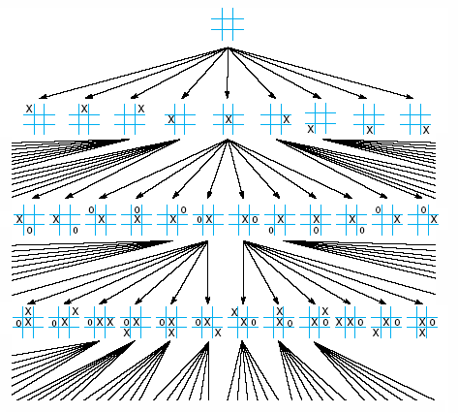
What is Search?
We define the state of the problem being solved as the values of the active variables
this will include any partial solutions, previous conclusions, user answers to questions, etc
while humans are often able to make intuitive leaps, or recall solutions with little thought, the computer must search through various combinations to find a solution
To the right is a search space for a tic-tac-toe game

Slide 27
Search Spaces and Types of Search
The search space consists of all possible states of the problem as it is being solved
A search space is often viewed as a tree and can very well consist of an exponential number of nodes making the search process intractable
Search spaces might be pre-enumerated or generated during the search process
Some search algorithms may search the entire space until a solution is found, others will only search parts of the space, possibly selecting where to search through a heuristic
Search spaces include
Game trees like the tic-tac-toe game
Decision trees (see next slides)
Combinations of rules to select in a production system
Networks of various forms (see next slides)
Other types of spaces

Slide 28
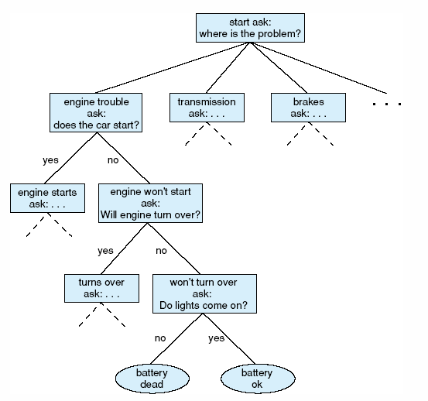
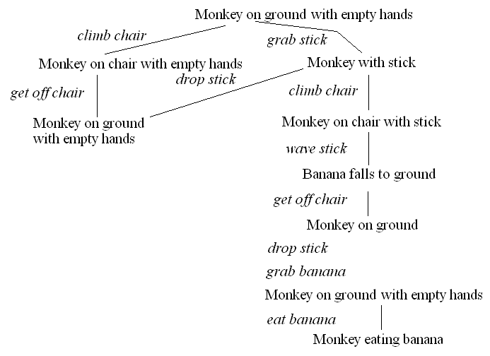
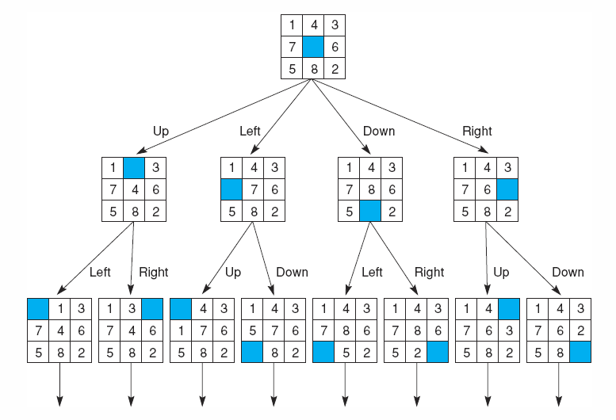
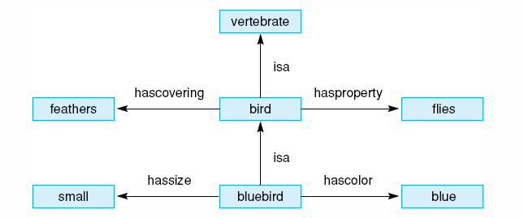

Slide 29
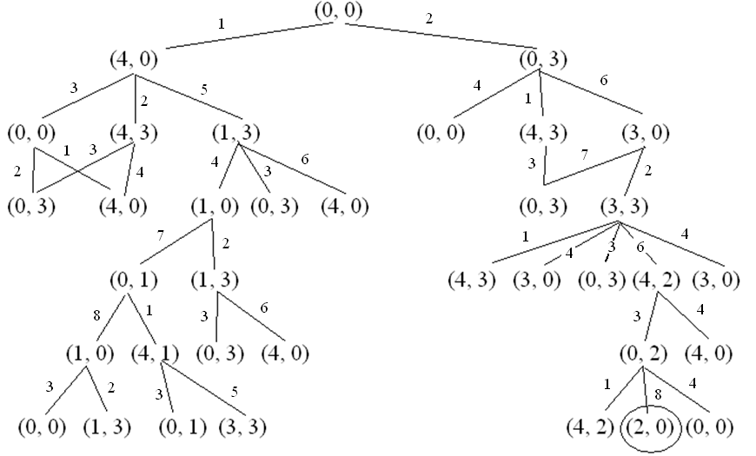
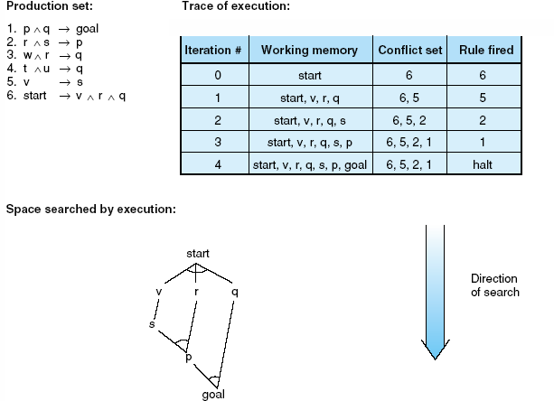

Slide 30
Search Algorithms and Representations
Breadth-first
Depth-first
Best-first (Heuristic Search)
A*
Hill Climbing
Limiting the number of Plies
Minimax
Alpha-Beta Pruning
Adding Constraints
Genetic Algorithms
Forward vs Backward Chaining
We will study various forms of representation and uncertainty handling in the next class period
Knowledge needs to be represented
Production systems of some form are very common
If-then rules
Predicate calculus rules
Operators
Other general forms include semantic networks, frames, scripts
Knowledge groups
Models, cases
Agents
Ontologies

Slide 31
A Brief History of AI: 1950s
Computers were thought of as an electronic brains
Term “Artificial Intelligence” coined by John McCarthy
John McCarthy also created Lisp in the late 1950s
Alan Turing defines intelligence as passing the Imitation Game (Turing Test)
AI research largely revolves around toy domains
Computers of the era didn’t have enough power or memory to solve useful problems
Problems being researched include
games (e.g., checkers)
primitive machine translation
blocks world (planning and natural language understanding within the toy domain)
early neural networks researched: the perceptron
automated theorem proving and mathematics problem solving

Slide 32
The 1960s
AI attempts to move beyond toy domains
Syntactic knowledge alone does not work, domain knowledge required
Early machine translation could translate English to Russian (“the spirit is willing but the flesh is weak” becomes “the vodka is good but the meat is spoiled”)
Earliest expert system created: Dendral
Perceptron research comes to a grinding halt when it is proved that a perceptron cannot learn the XOR operator
US sponsored research into AI targets specific areas – not including machine translation
Weizenbaum creates Eliza to demonstrate the futility of AI

Slide 33
1970s
AI researchers address real-world problems and solutions through expert (knowledge-based) systems
Medical diagnosis
Speech recognition
Planning
Design
Uncertainty handling implemented
Fuzzy logic
Certainty factors
Bayesian probabilities
AI begins to get noticed due to these successes
AI research increased
AI labs sprouting up everywhere
AI shells (tools) created
AI machines available for Lisp programming
Criticism: AI systems are too brittle, AI systems take too much time and effort to create, AI systems do not learn

Slide 34
1980s: AI Winter
Funding dries up leading to the AI Winter
Too many expectations were not met
Expert systems took too long to develop, too much money to invest, the results did not pay off
Neural Networks to the rescue!
Expert systems took programming, and took dozens of man-years of efforts to develop, but if we could get the computer to learn how to solve the problem…
Multi-layered back-propagation networks got around the problems of perceptrons
Neural network research heavily funded because it promised to solve the problems that symbolic AI could not
By 1990, funding for neural network research was slowly disappearing as well
Neural networks had their own problems and largely could not solve a majority of the AI problems being investigated
Panic! How can AI continue without funding?

Slide 35
1990s: ALife
The dumbest smart thing you can do is staying alive
We start over – lets not create intelligence, lets just create “life” and slowly build towards intelligence
Alife is the lower bound of AI
Alife includes
evolutionary learning techniques (genetic algorithms)
artificial neural networks for additional forms of learning
perception and motor control
adaptive systems
modeling the environment
Let’s disguise AI as something new, maybe we’ll get some funding that way!
Problems: genetic algorithms are useful in solving some optimization problems and some search-based problems, but not very useful for expert problems
perceptual problems are among the most difficult being solved, very slow progress

Slide 36
Today: The New (Old) AI
Look around, who is doing AI research?
By their own admission, AI researchers are not doing “AI”, they are doing
Intelligent agents, multi-agent systems/collaboration
Ontologies
Machine learning and data mining
Adaptive and perceptual systems
Robotics, path planning
Search engines, filtering, recommendation systems
Areas of current research interest:
NLU/Information Retrieval, Speech Recognition
Planning/Design, Diagnosis/Interpretation
Sensor Interpretation, Perception, Visual Understanding
Robotics
Approaches
Knowledge-based
Ontologies
Probabilistic (HMM, Bayesian Nets)
Neural Networks, Fuzzy Logic, Genetic Algorithms

Slide 37
THANK YOU

